Slide 1
What is Qubole?
Notes:
In this presentation we will introduce you to Qubole and what we’re about…

Slide 2
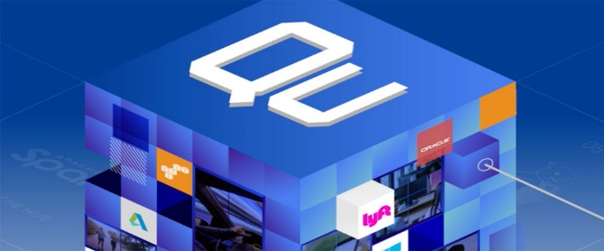
Introduction to Qubole
Qubole offers a self-service platform for Big Data analytics
Qubole provides a Hadoop managed service (Big Data as a Service)
Turn-key Hadoop infrastructure from the cloud
Ultimate goal is to empower data architects and data scientists
Changes the Big Data conversation from talk of clusters and nodes to analytics and business insights
Qubole customers focus on their data, not their data platform
Notes:
Qubole offers a self-service platform for Big Data analytics. You can think of it as “Big Data as a Service” (BDaaS). Qubole provides a turnkey Hadoop managed service infrastructure from the cloud. The ultimate goal is to empower data architects, analysts, and data scientists and to change the big data conversation from the talk of clusters and nodes to analytics and business insights - where the value of data is realized.
This cloud-based data platform self-manages, self-optimizes, and learns to improve automatically and, as a result, delivers unbeatable agility, flexibility, and TCO.
Qubole customers focus on their data, not their data platform.

Slide 3
Big Data
Big data means a collection of large datasets that cannot be processed using traditional computing techniques
Includes huge volume, high velocity, and extensible variety of data
Structured data (RDBMS records)
Semi-structure data (XML data)
Unstructured data (Word, PDF, Text, Images)
Challenges:
Capturing data
Curation
Storage
Sharing
Transfer
Analysis
Presentation
Notes:
So let’s take a step back and briefly review what Big Data is…
Big Data means a collection of large datasets that cannot be processed using traditional computing techniques.
Big Data includes huge volume, high-velocity, and extensible variety of data, including… Structured data, Semi-structured data, and unstructured data.
The challenges facing you in a big data system are:
Capturing the data, curation, storage, sharing, transfer, analysis (or getting additional value out of it), and presentation.

Slide 4
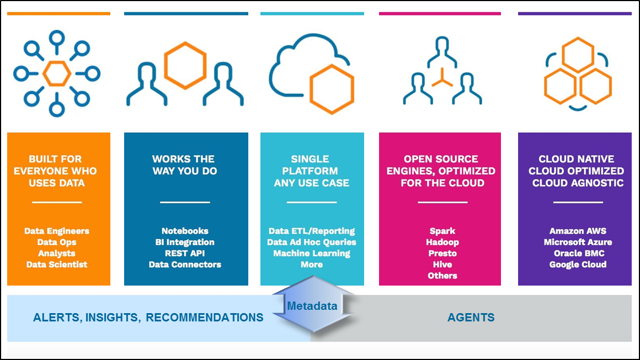
Big Data Your Way
Notes:
Qubole provides freedom in terms of choice at the heart of democratizing data access.
QDS is built for everyone who uses data, like Data Engineers, Data Ops, Data Scientists, and Data Analysts.
It’s designed to work the way you do, supporting any type of Interface. The QDS is accessible via REST APIs. You can use Notebooks to build advanced models and visualize data, the BI interface, Command Line, APIs, and Data Connectors.
QDS is designed as a single platform for any use-case – You can use APIs to schedule data ETL and Reporting jobs. You can use the Analyze UI to create and run Ad-hoc queries. It also provides comprehensive support for deep learning, including numeric computing and high-level neural networks.
QDS is based on Open Source engines or services such as Hadoop, Spark, Hive, Presto, Airflow, and others.
It runs on any of the major Public Cloud platforms like Amazon AWS, Microsoft Azure, Google Cloud, and Oracle.
Cloud Agents give you several advanced automation capabilities
Qubole’s Alerts, Insight, and Recommendations, or AIR, collects metadata generated from data platform usage, analyzes it, and provides insights and recommendations to all types of users, such as Data Consumers, which are Analysts, Data Scientists, and Data Engineers, and Data Service providers, who are the Admins.

Slide 5
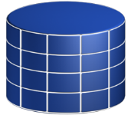
What is Hadoop?
Hadoop is an open-source framework that enables storage and process of big data in a distributed environment across clusters of computers using simple programming models
Designed to scale up from single servers to thousands of machines, each offering local computation and storage
Runs applications using the MapReduce algorithm
Hadoop Framework
HDFS
Map Reduce
Media Data
Map Reduce
System Log File
Map Reduce
Relational Database
Notes:
So what’s all this talk about Hadoop?
In 2005, Doug Cutting, Mike Cafarella, and their team took the solution provided by Google MapReduce and started an Open Source project called HADOOP. Doug named the project after his son’s toy elephant. Now, Apache Hadoop is a registered trademark of the Apache Software Foundation.
Hadoop is an open-source framework that enables storage and process of big data in a distributed environment across clusters of computers using simple programming models. It’s designed to scale up from single servers to thousands of machines, each offering local computation and storage.
Hadoop runs applications using the MapReduce algorithm, where the data is processed in parallel on different CPU nodes. The Hadoop framework is capable enough to support applications capable of running on clusters of computers and they could perform complete statistical analysis for a huge amount of data.

Slide 6
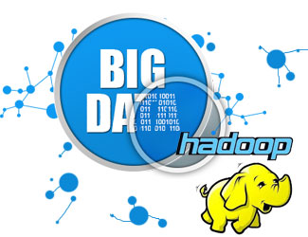
Bottlenecks with Hadoop
There are bottlenecks to getting Hadoop deployments provisioned:
The upfront costs for hardware and expert staff
The complexity of deploying and maintaining Hadoop clusters and related software
Lack of talented Big Data infrastructure and hardware professionals
Notes:
There are some bottlenecks to overcome when getting Hadoop deployments launched.
First are the upfront costs for hardware and expert staff.
Second is the complexity of deploying and maintaining Hadoop clusters and related software.
Another problem is often the lack of talented big data infrastructure and hardware professionals.

Slide 7
Qubole Data Service (QDS)
Qubole Data Service (QDS) uses the public cloud to abstract the complexities of Hadoop infrastructure operations
Drives activities like provisioning, orchestration, management, auto-scaling, data visualization, etc.
QDS starts with many data connectors for importing and exporting data to and from the platform
Qubole’s managed Hadoop platform supports Spark, Hive, Presto and an SDK for building applications in Python
Data is stored in S3 and Hadoop clusters include Auto-Scaling
MapReduce jobs and SQL-style queries are created via a GUI
Run queries to analyze your data, schedule jobs, and visualize data to detect patterns
Notes:
The Qubole Data Service uses the public cloud to abstract the complexities of Hadoop infrastructure operations. It drives activities like provisioning, orchestration, management, auto-scaling, data visualization, and so on. It starts with more than a dozen data connectors for importing and exporting data to and from the platform, including connectors for MongoDB, Google Analytics, HP Vertica, and Oracle to name a few. The core of the service is Qubole’s managed Hadoop platform, which includes support for Hive, Sqoop, Pig, and Oozie, as well as an SDK for building applications in Python.
Data is stored in S3 - and Hadoop clusters include Auto-Scaling capabilities. MapReduce jobs and SQL-style queries can be created using an interactive graphical interface. You can run queries to analyze your data, schedule jobs, and visualize data to detect patterns.

Slide 8
Managed Cloud Service
Qubole handles all operations
Users don’t need to provision hardware, configure clusters, or continually tune clusters to maintain performance
Cluster are spun-up ONLY when jobs are kicked off
Automatically expanded or contracted based on workloads
Compatible with AWS Spot market
Qubole uses Hive, the open source data warehouse framework
Includes IO optimizers for S3
QDS also supports Presto for performing SQL-style analytics against petabytes of data
Requires users to move critical data to the cloud.
Notes:
As a managed cloud service, Qubole handles all operations, meaning users don’t need to provision hardware, configure clusters, or continually tune clusters to maintain performance. Clusters are spun-up only when jobs are kicked off and they are automatically expanded or contracted based on the characteristics of given workloads. QDS also leverages AWS’s Spot market, allowing users to bid on Spot instances based on maximum willing price.
As for performance, Qubole has optimized Hive, the open source data warehouse framework for querying Hadoop data. In addition, we have built IO optimizers for S3.
QDS also supports Presto, another open source project for performing interactive SQL-style analytics against petabytes of data. Like Hive, Presto was also created by Facebook. Facebook claims Presto is orders of magnitude more efficient than Hive and can return query results in milliseconds.
The benefits of a Hadoop managed service like QDS is that it removes the need for upfront capital expenditure on hardware and the need to hire expensive and scarce Big Data practitioners. Users can focus their attention on distilling actionable insights from the data rather than on maintaining the infrastructure to support such analysis. But it requires users to move critical data to the cloud, where security and SLA standards do not always match expectations.

Slide 9
Cuts Cloud Costs in Half
QDS cost-saving approach involves three elements:
Separating compute and storage.
Optimizing compute node allocation
Optimizing the cost of nodes
In 2017, Qubole saved customers $140M in cloud costs by smartly - and automatically – leveraging all the cloud resources available to businesses
Qubole customers currently process nearly an exabyte of data every month
Use the online TCO Calculator to find out how much extra efficiency is possible for your data processing with Qubole
Notes:
The scalability, agility, and cost savings promise of the cloud can only be fully realized if resources are optimally managed. Public clouds, like AWS, offer different types of cloud resources for a reason. There are cheaper AWS S3, more expensive EC2, spare-capacity Spot instances that can be purchased at a discount, and more. While this portfolio of resources offers the possibility of rapid scaling, agility, and cost savings, actually putting these principles into practice is not straightforward. Many companies are missing out on a massive cost savings by not using these resources as efficiently as possible.
Qubole’s Qubole Data Service (QDS) is designed to maximize that potential savings by allocating exactly the right cloud resources for every job. We’ve found that the QDS formula typically offers customers a 50% reduction in total cost of ownership, and as much as 80% in some cases. In 2017, Qubole saved customers $140M in cloud costs by smartly - and automatically – leveraging all the cloud resources available to the businesses.
There are three elements to this cost-saving approach with QDS:
1. Separating compute and storage. QDS automatically allocates cheaper resources, like AWS S3 for persistent storage, and brings faster, more expensive resources like AWS EC2 online only when they’re needed for data processing. QDS Cluster Lifecycle management automatically starts and stops these clusters as they’re needed, reducing the cost of running idle clusters.
2. Optimizing compute node allocation. Even while clusters are running, QDS intelligently and predictively adds and subtracts nodes to provide maximum efficiency. With QDS, you can avoid the common industry practice of provisioning a cluster for peak demand.
3. Optimizing the cost of nodes. QDS automatically shops the market for discounted Spot nodes and integrates them with other node types in heterogeneous clusters. With this approach, cost, performance, and availability can be maximized by employing exactly the right mix of machines for every workload—even if they’re not of the same type.
Optimized Spot allocation and heterogeneous clusters alone have allowed Oracle Data Cloud to reduce its spending 90% compared to using on-demand nodes… and 20-50% compared to their previous cost-saving practice of using Spot-only clusters.
You can use our online TCO Calculator to find out how much extra efficiency is possible for your data processing with Qubole.

Slide 10
Thank-you
Qubole provides you automated Big Data your way through an open-source Hadoop framework
Easier and less expensive to operate and maintain
Qubole has everything you need in a Big Data as a Service platform
www.qubole.com

